Slide 1


The cost of resource use for photosynthesis drives variance in leaf nitrogen content across a climate and soil resource availability gradient
Evan A. Perkowski; Nicholas G. Smith

Slide 2
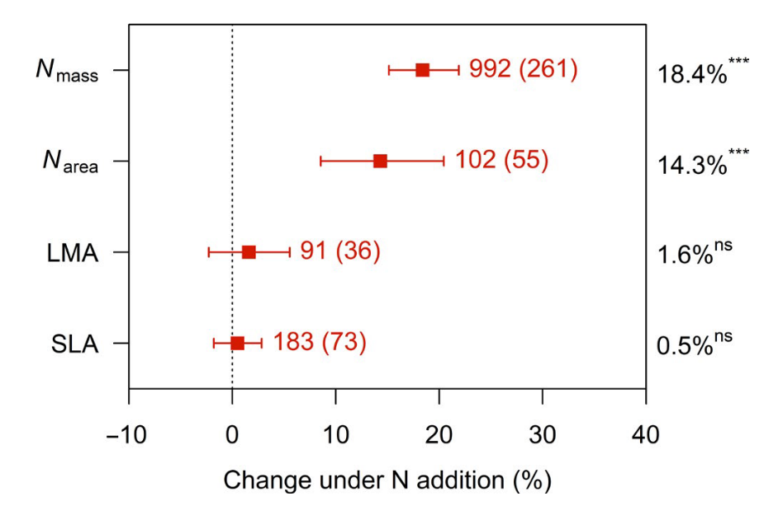
Soil nitrogen generally increases leaf nitrogen
Firn et al. (2019) Nature
Notes:
Soil nitrogen has been shown to positively influence leaf nitrogen in a fair share of studies.
This figure is from a study by Jenn Firn in 2019 using a globally coordinated nutrient addition experiment by the name Nutrient Network.
In these experiments, nitrogen, phosphorus, and potassium are added in a full-factorial field manipulation in grassland systems
On the x-axis is the different combinations of nutrient additions, and on the y-axis is leaf nitrogen concentrations

Slide 3
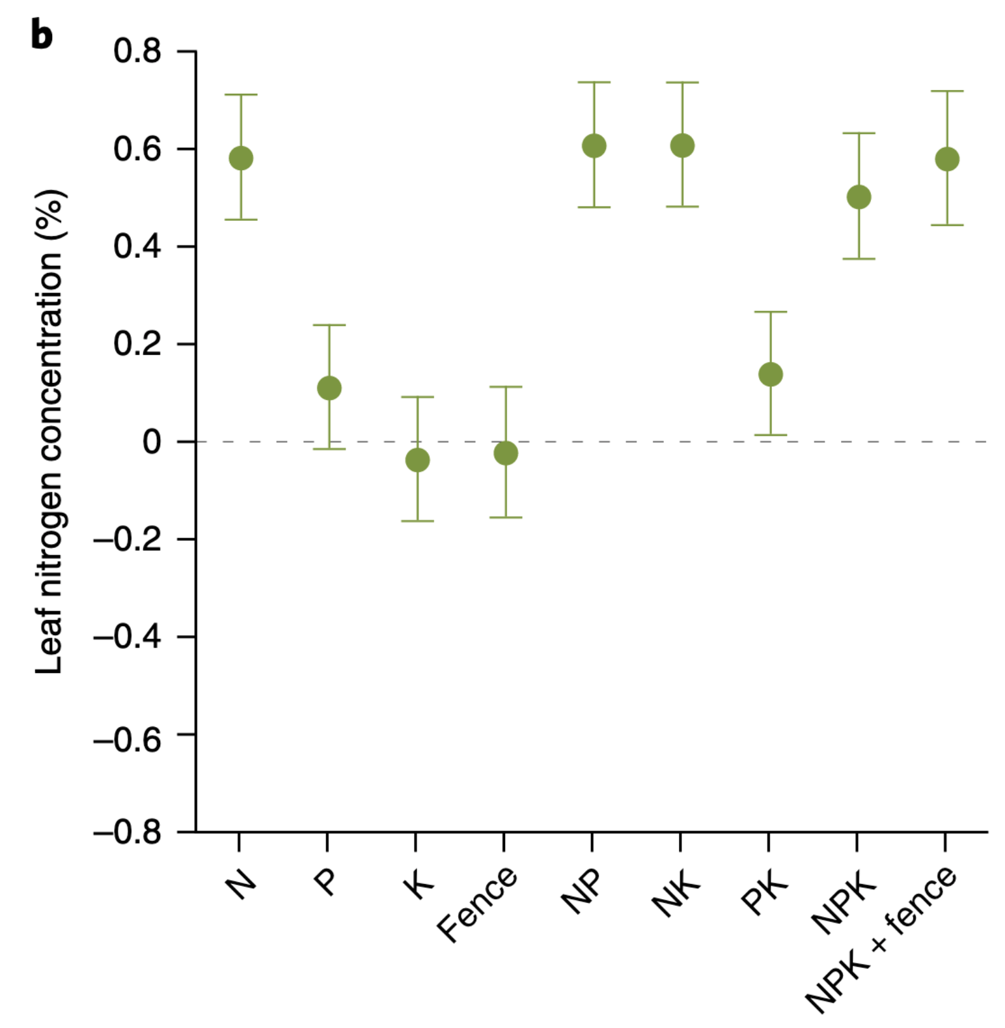
Soil nitrogen generally increases leaf nitrogen
Plots that receive nitrogen have higher leaf nitrogen content
Firn et al. (2019) Nature
Notes:
You can see that there is a pretty obvious increase in leaf nitrogen content in plots that receive nitrogen fertilizer regardless of potassium and phosphorus combinations

Slide 4
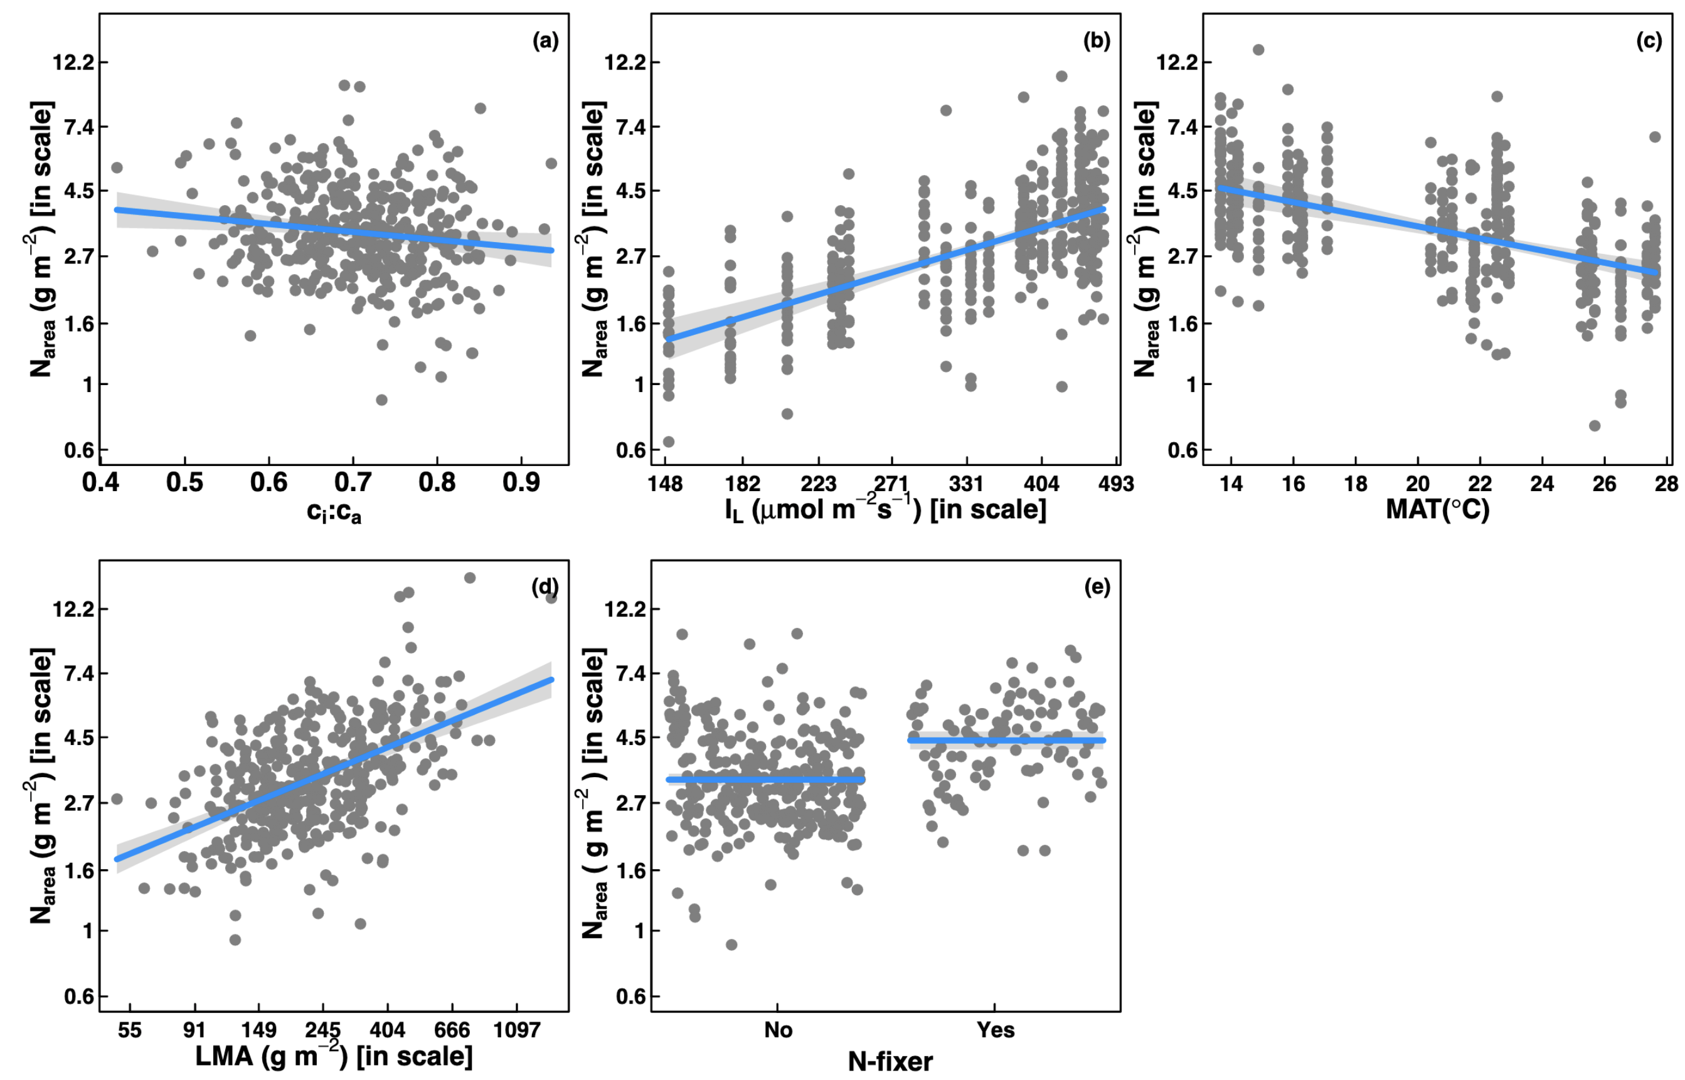
… but leaf nitrogen can be predicted independent of soil nitrogen
Dong et al. (2017) Biogeosciences
Notes:
Some recent work has also shown that leaf nitrogen can be predicted independent of soil nitrogen availability
This is work from Ning Dong showing on the top row in panel b and c that leaf nitrogen can be predicted from photosynthetically active radiation, which is basically light, and mean annual temperature.
Additionally, they show in panel a that leaf nitrogen can be predicted by the ratio of intercellular carbon dioxide to extracellular carbon dioxide, or Ci:Ca,
In panel d, they show that leaf nitrogen can be predicted through the ratio of intercellular carbon dioxide to atmospheric carbon dioxide, and in panel e show that leaf nitrogen can be predicted on the basis of whether a species can associate with nitrogen-fixing bacteria
Thus, aboveground climate and leaf traits can be used to predict patterns of leaf nitrogen

Slide 5
Leaf N is likely a product of interactions between climatic and edaphic factors
Notes:
While we know that variation in leaf nitrogen can be explained by soil nitrogen availability, climate, or plant traits, we still do not have a firm grasp of what drives leaf nitrogen content.
It is possible that these patterns are driven by plant allocation responses to soil nitrogen and climate, but we lack data that links these responses to physiological processes that range from the leaf to whole plant level
Yet, we do not fully understand when and where soil nitrogen impacts nitrogen allocation to leaf tissue vs. other tissues

Slide 6
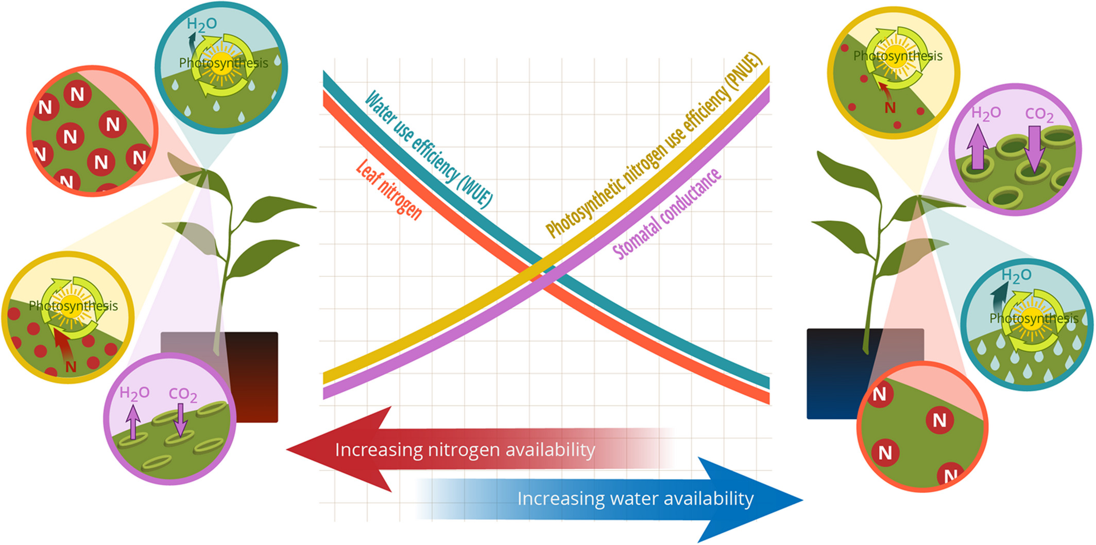
Photosynthetic ‘least-cost’ theory: leaves acclimate to changing climatic and edaphic environments via summed cost of resource use (nitrogen and water)
Bialic-Murphy et al. (2021) Ecology Letters
Notes:
At the leaf level, plants might allocate nitrogen to photosynthetic leaf tissue in order to preserve water
This option can be explained through recent frameworks suggesting that plants can and should maximize photosynthetic carbon gain by trading inefficient use of an abundant resource for efficiency a more limited limiting resource.
For example, if nitrogen is relatively more available than water, then plants can maintain a similar photosynthetic output by increasing nitrogen allocation toward photosynthetic leaf tissue in order to increase water-use efficiency., effectively employing a water-savings mechanism
We might expect these patterns would be observed in arid systems where water is relatively less available than nitrogen, although these patterns haven’t necessarily been tested in temperate regions

Slide 7
Photosynthetic ‘least-cost’ theory: leaves acclimate to changing climatic and edaphic environments via summed cost of resource use (nitrogen and water)
Bialic-Murphy et al. (2021) Ecology Letters
Notes:
At the leaf level, plants might allocate nitrogen to photosynthetic leaf tissue in order to preserve water
This option can be explained through recent frameworks suggesting that plants can and should maximize photosynthetic carbon gain by trading inefficient use of an abundant resource for efficiency a more limited limiting resource.
For example, if nitrogen is relatively more available than water, then plants can maintain a similar photosynthetic output by increasing nitrogen allocation toward photosynthetic leaf tissue in order to increase water-use efficiency., effectively employing a water-savings mechanism
We might expect these patterns would be observed in arid systems where water is relatively less available than nitrogen, although these patterns haven’t necessarily been tested in temperate regions

Slide 8
Hypotheses
SM₉₀
N_{fixer}
VPD₄
N_{mass}
β
C_{i}:C_{a}
Ν_{area}
Soil N
C₃/C₄
M_{area}

Slide 9
The cost of acquiring and using nutrients (β) will be modified by soil resources and species identity
SM₉₀
N_{fixer}
VPD₄
N_{mass}
β
C_{i}:C_{a}
Ν_{area}
Soil N
C₃/C₄
M_{area}

Slide 10
Leaf C_{i}:C_{a} will be modified by costs of resource use and aboveground climate
SM₉₀
N_{fixer}
VPD₄
N_{mass}
β
C_{i}:C_{a}
Ν_{area}
Soil N
C₃/C₄
M_{area}

Slide 11
Leaf nitrogen content will be negatively related to leaf C_{i}:C_{a}
SM₉₀
N_{fixer}
VPD₄
N_{mass}
β
C_{i}:C_{a}
Ν_{area}
Soil N
C₃/C₄
M_{area}

Slide 12
Soil N may directly increase N_{area} due to increasing N_{mass}…
SM₉₀
N_{fixer}
VPD₄
N_{mass}
β
C_{i}:C_{a}
Ν_{area}
Soil N
C₃/C₄
M_{area}

Slide 13
… or may indirectly increase N_{area} due to reductions in the cost of acquiring nitrogen
SM₉₀
N_{fixer}
VPD₄
N_{mass}
β
C_{i}:C_{a}
Ν_{area}
Soil N
C₃/C₄
M_{area}

Slide 14
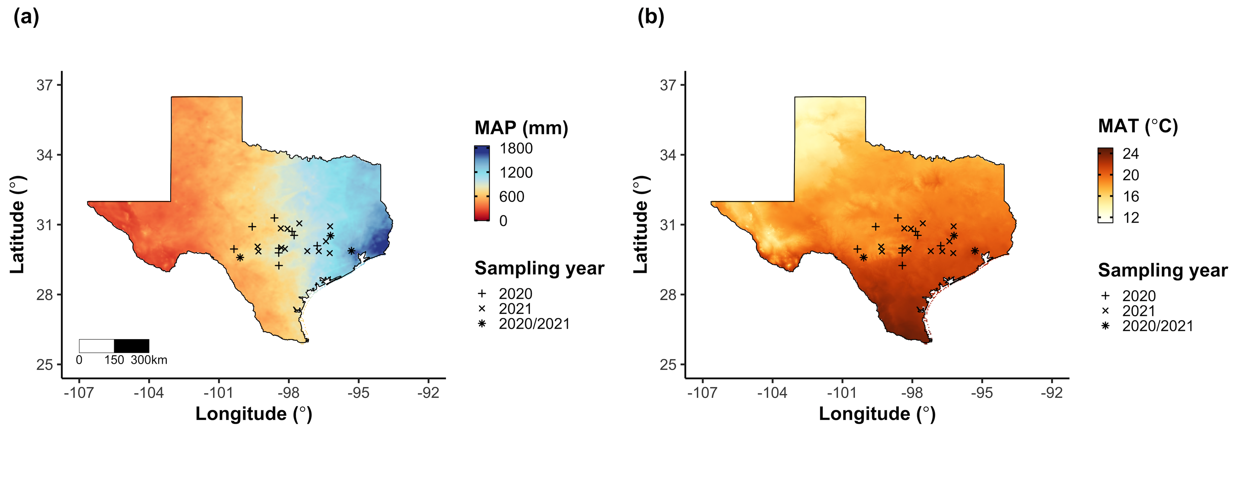
Field gradient experiment
24 sites
12 visited in 2020
15 visited in 2021 (3 from 2020)
3 leaves of 5 most dominant species at each site
Leaf nitrogen content
Leaf C_{i}:C_{a} (δ¹³C)
Cost of acquiring nitrogen relative to water (β)
Composite soil sample
[NO₃-N]

Slide 15
Climate and edaphic characteristics
PRISM data product (4-km grid across coterminous US)
Daily air temperature
Daily vapor pressure deficit
Daily precipitation
Soil moisture derived from SPLASH model
As function of water holding capacity

Slide 16
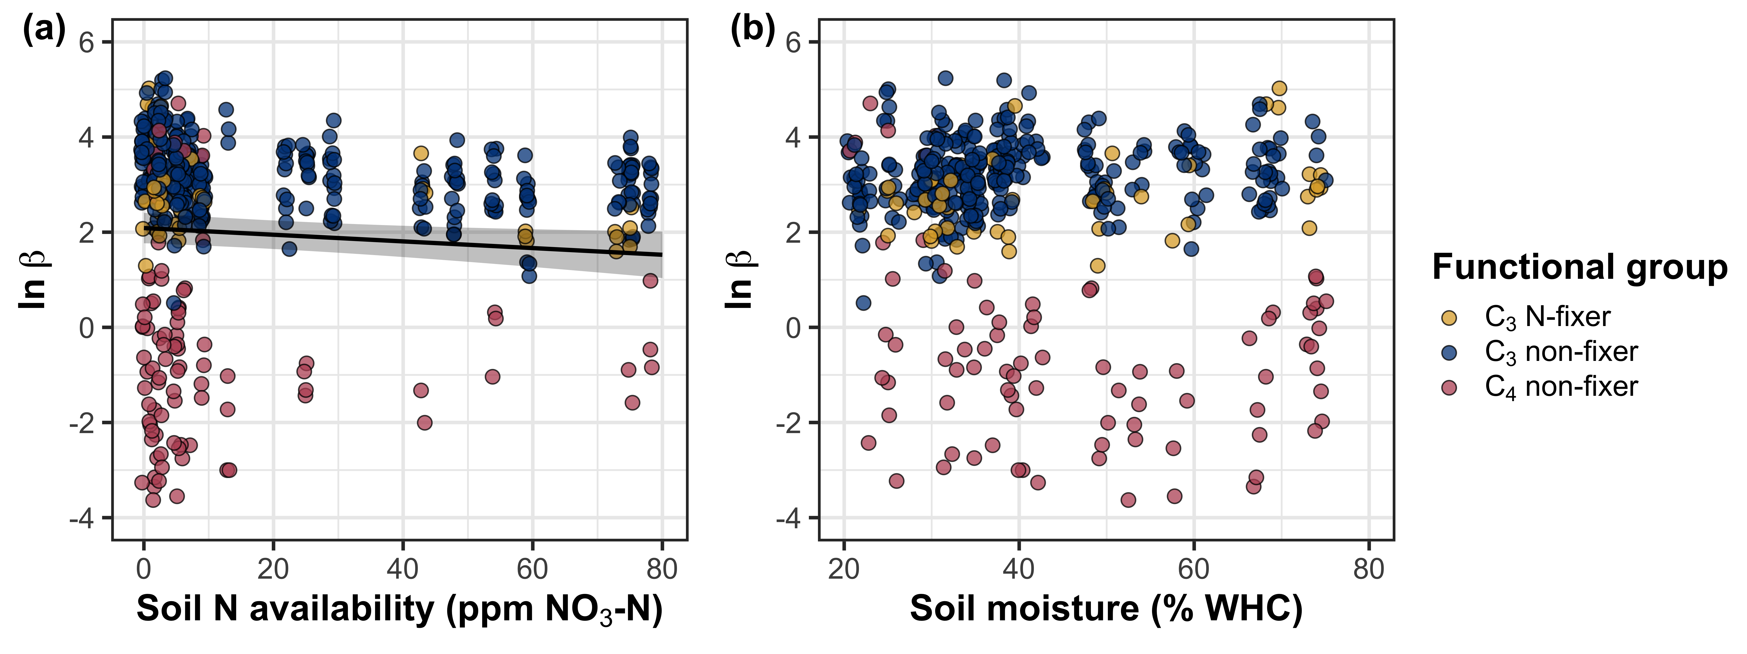
β decreases with increasing soil nitrogen, but is not modified by soil moisture

Slide 17
β decreases with increasing soil nitrogen, but is not modified by soil moisture

Slide 18
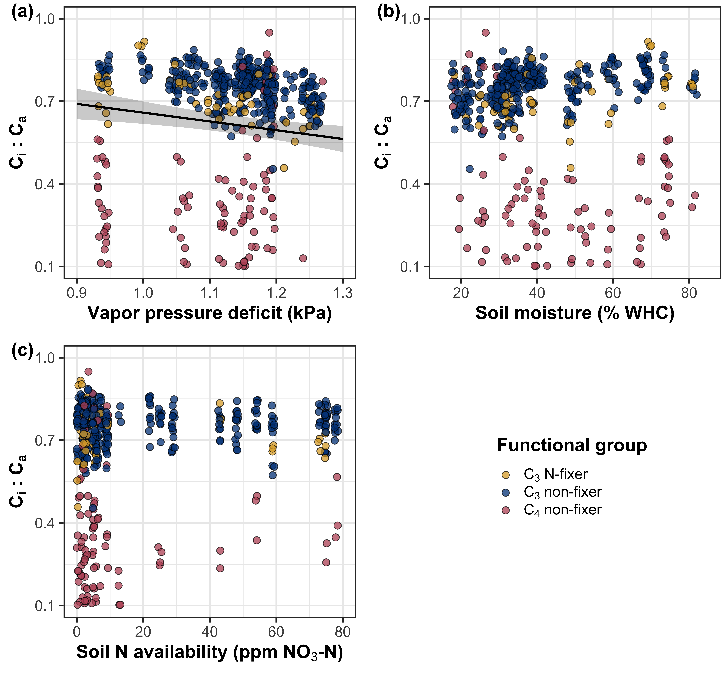
Leaf C_{i}:C_{a} decreases with increasing vapor pressure deficit

Slide 19
N_{area} increases with increasing soil nitrogen availability

Slide 20
N_{area} increases with increasing soil nitrogen availability

Slide 21
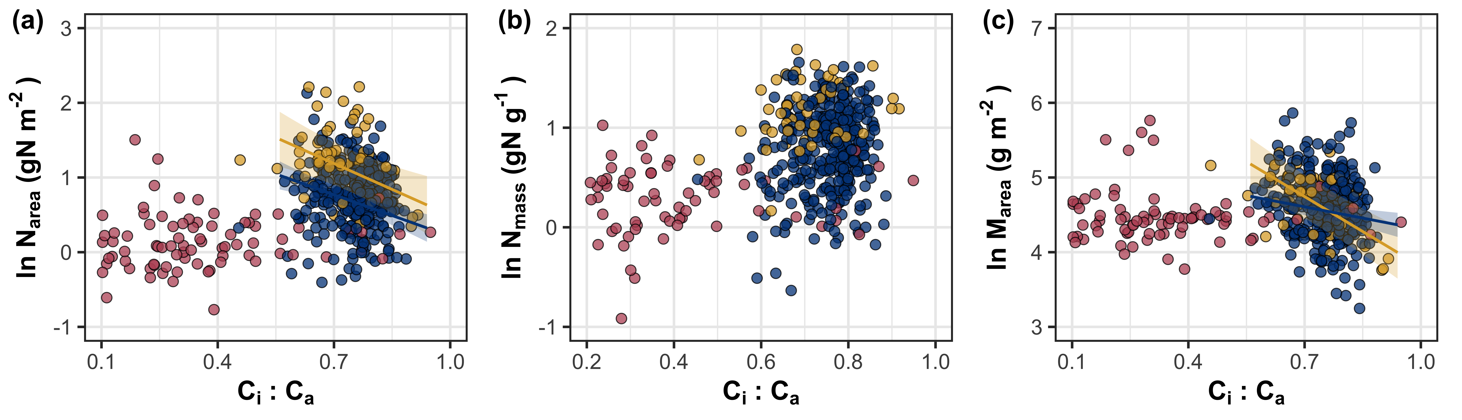
N_{area} is negatively associated with leaf C_{i}:C_{a} due to reductions in M_{area}

Slide 22
Putting it all together through a piecewise structural equation model
SM₉₀
N_{fixer}
VPD₄
N_{mass}
β
C_{i}:C_{a}
Ν_{area}
Soil N
C₃/C₄
M_{area}

Slide 23
SM₉₀
N_{fixer}
VPD₄
N_{mass}
β
C_{i}:C_{a}
Ν_{area}
Soil N
C₃/C₄
M_{area}

Slide 24
β is negatively associated with increasing soil nitrogen, and generally lower in C₄ species
SM₉₀
N_{fixer}
VPD₄
N_{mass}
β
C_{i}:C_{a}
Ν_{area}
Soil N
C₃/C₄
M_{area}

Slide 25
β is negatively associated with increasing soil nitrogen, and generally lower in C₄ species
SM₉₀
N_{fixer}
VPD₄
N_{mass}
β
C_{i}:C_{a}
Ν_{area}
Soil N
C₃/C₄
M_{area}

Slide 26
SM₉₀
N_{fixer}
VPD₄
N_{mass}
β
C_{i}:C_{a}
Ν_{area}
Soil N
C₃/C₄
M_{area}

Slide 27
Leaf C_{i}:C_{a} is negatively related to increasing vapor pressure deficit and positively related to β
SM₉₀
N_{fixer}
VPD₄
N_{mass}
β
C_{i}:C_{a}
Ν_{area}
Soil N
C₃/C₄
M_{area}

Slide 28
SM₉₀
N_{fixer}
VPD₄
N_{mass}
β
C_{i}:C_{a}
Ν_{area}
Soil N
C₃/C₄
M_{area}

Slide 29
M_{area} is negatively related to leaf C_{i}:C_{a}, while N_{mass} is positively related to leaf C_{i}:C_{a}
SM₉₀
N_{fixer}
VPD₄
N_{mass}
β
C_{i}:C_{a}
Ν_{area}
Soil N
C₃/C₄
M_{area}

Slide 30
SM₉₀
N_{fixer}
VPD₄
N_{mass}
β
C_{i}:C_{a}
Ν_{area}
Soil N
C₃/C₄
M_{area}

Slide 31
Increasing soil nitrogen availability directly increases N_{mass} and decreases M_{area}
SM₉₀
N_{fixer}
VPD₄
N_{mass}
β
C_{i}:C_{a}
Ν_{area}
Soil N
C₃/C₄
M_{area}

Slide 32
SM₉₀
N_{fixer}
VPD₄
N_{mass}
β
C_{i}:C_{a}
Ν_{area}
Soil N
C₃/C₄
M_{area}

Slide 33
N-fixation ability directly increases N_{mass}
SM₉₀
N_{fixer}
VPD₄
N_{mass}
β
C_{i}:C_{a}
Ν_{area}
Soil N
C₃/C₄
M_{area}

Slide 34
SM₉₀
N_{fixer}
VPD₄
N_{mass}
β
C_{i}:C_{a}
Ν_{area}
Soil N
C₃/C₄
M_{area}

Slide 35
M_{area} is negatively associated with N_{mass}
SM₉₀
N_{fixer}
VPD₄
N_{mass}
β
C_{i}:C_{a}
Ν_{area}
Soil N
C₃/C₄
M_{area}

Slide 36
SM₉₀
N_{fixer}
VPD₄
N_{mass}
β
C_{i}:C_{a}
Ν_{area}
Soil N
C₃/C₄
M_{area}

Slide 37
Soil moisture was positively associated with soil nitrogen availability
SM₉₀
N_{fixer}
VPD₄
N_{mass}
β
C_{i}:C_{a}
Ν_{area}
Soil N
C₃/C₄
M_{area}

Slide 38
55%
SM₉₀
N_{fixer}
VPD₄
N_{mass}
38%
82%
89%
β
C_{i}:C_{a}
Ν_{area}
35%
56%
Soil N
C₃/C₄
M_{area}

Slide 39
Soil N directly modified N_{area} due to changes in N_{mass}…
55%
SM₉₀
N_{fixer}
VPD₄
N_{mass}
38%
82%
89%
β
C_{i}:C_{a}
Ν_{area}
35%
56%
Soil N
C₃/C₄
M_{area}

Slide 40
Soil N directly modified N_{area} due to changes in N_{mass}…
55%
SM₉₀
N_{fixer}
VPD₄
N_{mass}
38%
82%
89%
β
C_{i}:C_{a}
Ν_{area}
35%
56%
Soil N
C₃/C₄
M_{area}

Slide 41
… and indirectly modified N_{area} due to changes in the cost of acquiring nitrogen
55%
SM₉₀
N_{fixer}
VPD₄
N_{mass}
38%
82%
89%
β
C_{i}:C_{a}
Ν_{area}
35%
56%
Soil N
C₃/C₄
M_{area}

Slide 42

Acknowledgements
Field and lab assistance (*UG mentees)
Risa McNellis
Jorge Ochoa*
Peter Eludini
Christine Vanginault*
Abigail Bell*
Jose Villeda*
Hannah German*
Avery Schoenherr*
Travel funds
ESA Biogeosciences Section
ESA Physiological Ecology Section

Slide 43


Slide 44
Extra slides

Slide 45
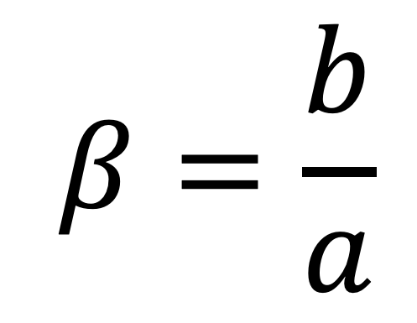
Resource unit cost ratio (β)
cost of acquiring and using N
$$β=\frac{b}{a}$$
cost of acquiring and using H₂O

Slide 46
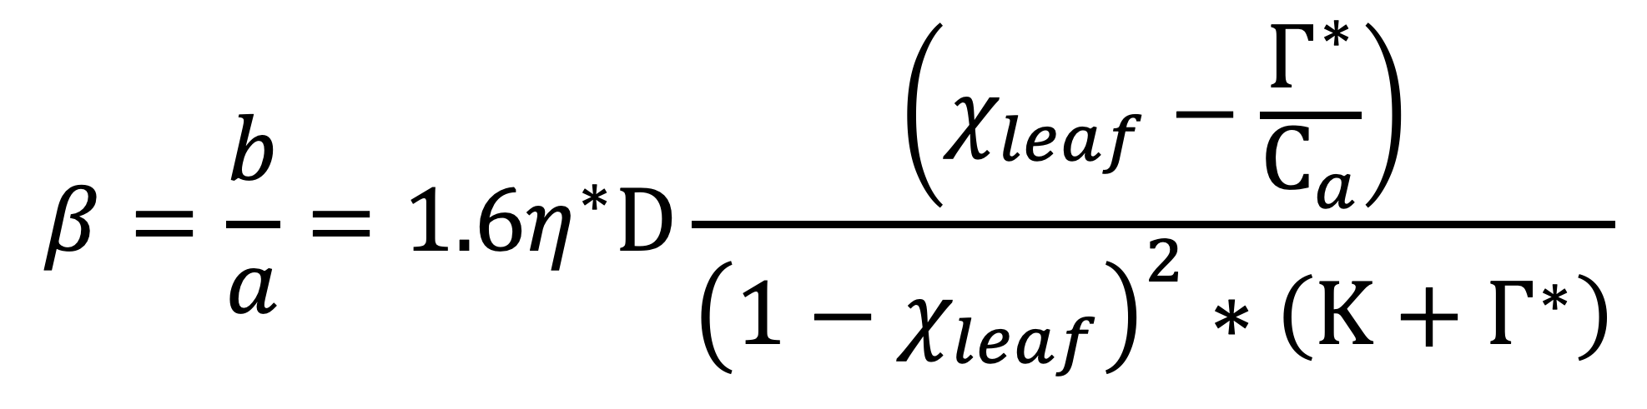
Resource unit cost ratio (β)
$$β=\frac{b}{a}=1.6η^{∗}D\frac{\left(χ_{leaf}−\frac{Γ^{∗}}{C_{a}}\right)}{{\left(1−χ_{leaf}\right)}^{2}∗\left(Κ+Γ^{∗}\right)}$$
Notes:
We used the following field manipulation experiment to investigate whether changes in soil resource availability influenced leaf quantity/quality tradeoffs or water/nitrogen use tradeoffs.
Starting in 2010, our coauthor Christy Goodale set up a full-factorial nitrogen-by-sulfur field manipulation experiment at three sites in a contiguous closed canopy forest all within a 20-km radius of Ithaca, New York
This experiment was originally created to tease apart the impacts of soil pH change and soil nitrogen fertilization on forest ecosystem functions;
however, because sulfur additions acidify the soil and promote nitrogen losses over time, this system provides a unique soil nitrogen availability gradient to test our hypotheses

